Slide 1


Stock Market’s Closing Price Prediction with LSTM,CNN and ARIMA
STAT 430 Fundamentals of Deep Learning
Presenters:
Gan Yao, Yuhang Gong, Zixuan Wang

Slide 2

Introduction
STAT 430 Fundamentals of Deep Learning

Slide 3
Introduction
Overview
This project aims at applying both linear (ARIMA) and non-linear models (LSTM, CNN) to predict and study the trends in stock prices based on four stocks - Facebook (FB), Microsoft (MSFT), Procter & Gamble (PG) and Amazon (AMZN)
The stock market is a volatile and dynamic system which makes the prediction of the stock market prices a very important and challenging problem.
Applying deep learning algorithm in stock market’s price prediction can be highly lucrative.
Dataset
1259 records from “2017-04-11” to “2022-04-08”
First 80% is used as training set, the rest 20% is used as testing set.
 | Input | Output
LSTM | A tensor of length n with 1 feature of the preceding n days | The close price at the n+1 day
CNN | A tensor of length n with 6 features of the preceding n days | The close price at the n+1 day
Date | Open | High | Low | Close | Adj Close | Volume
2017-04-11 | 907.04 | 911.24 | 897.50 | 902.36 | 902.36 | 3012700
2017-04-12 | 903.09 | 904.09 | 895.25 | 896.23 | 896.23 | 2456100
2017-04-13 | 891.45 | 894.97 | 884.49 | 884.67 | 884.67 | 3174600
2017-04-17 | 887.50 | 902.38 | 887.50 | 901.99 | 901.99 | 2854700
2017-04-18 | 900.99 | 909.61 | 900.78 | 903.78 | 903.78 | 2999200
LSTM CNN
Date | Close
2017-04-19 | 905.04
Date | Close
2017-04-19 | 906.34
STAT 430 Fundamentals of Deep Learning

Slide 4
Long Short Term Memory
STAT 430 Fundamentals of Deep Learning

Slide 5
Long Short Term Memory
LSTM related work
Nelson (2017) demonstrated the standard process of developing a LSTM classification model on stock market price prediction.
Liu (2018) calculated the moving average, exponential moving average based on the stock data and used them as features when training LSTM model
Roondiwala (2015) used a more complicated LSTM architecture. They added 2 LSTM layers and dense layer with ReLU activation and used RMSE to evaluate the performance of the LSTM model.
We integrated the LSTM architectures mentioned above and added more layers to achieve better predictions.
STAT 430 Fundamentals of Deep Learning

Slide 6
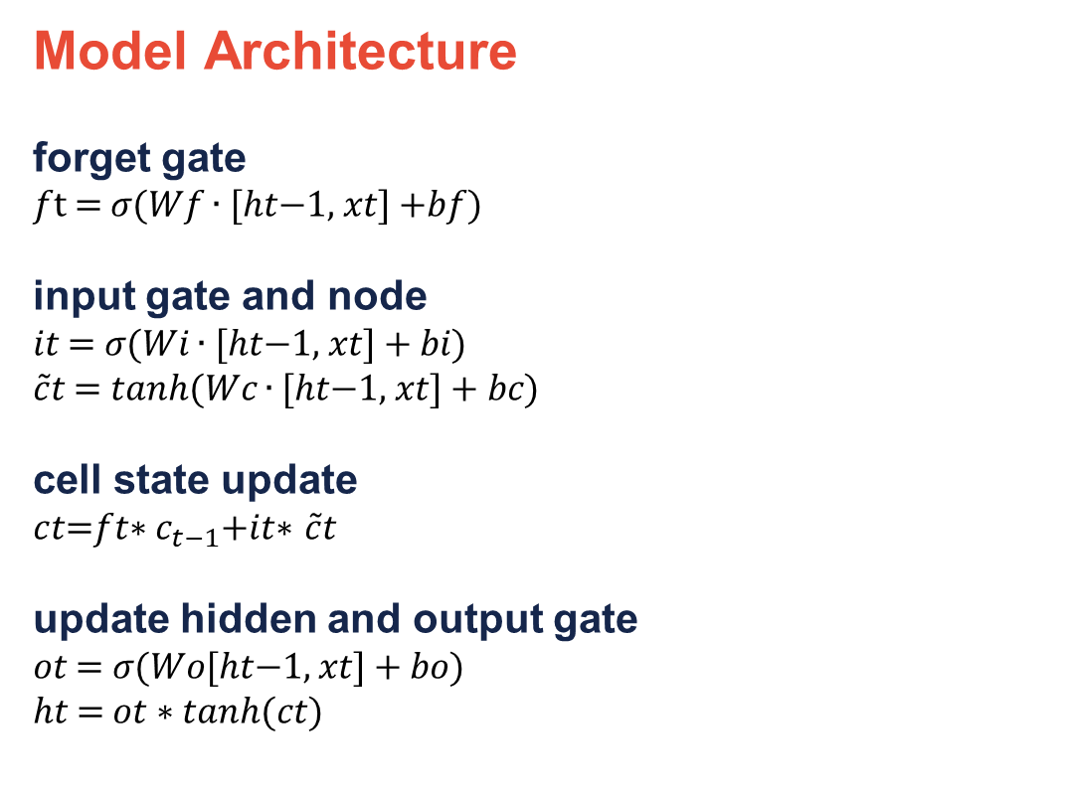
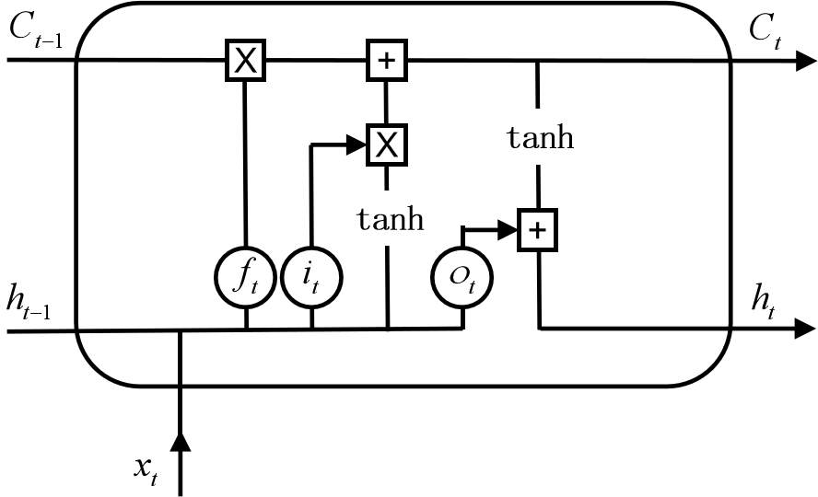
Long Short Term Memory
IMAGE / GRAPHIC
STAT 430 Fundamentals of Deep Learning

Slide 7
Convolutional Neural Network
STAT 430 Fundamentals of Deep Learning

Slide 8
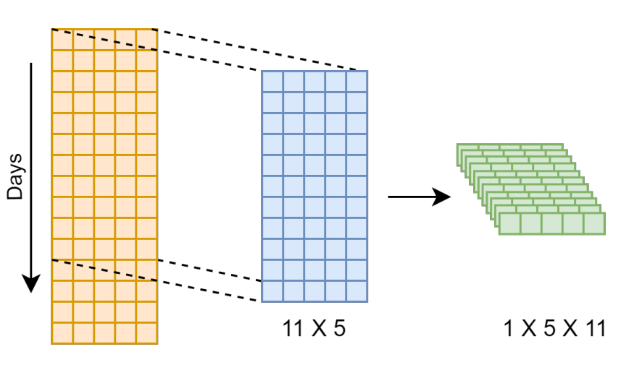
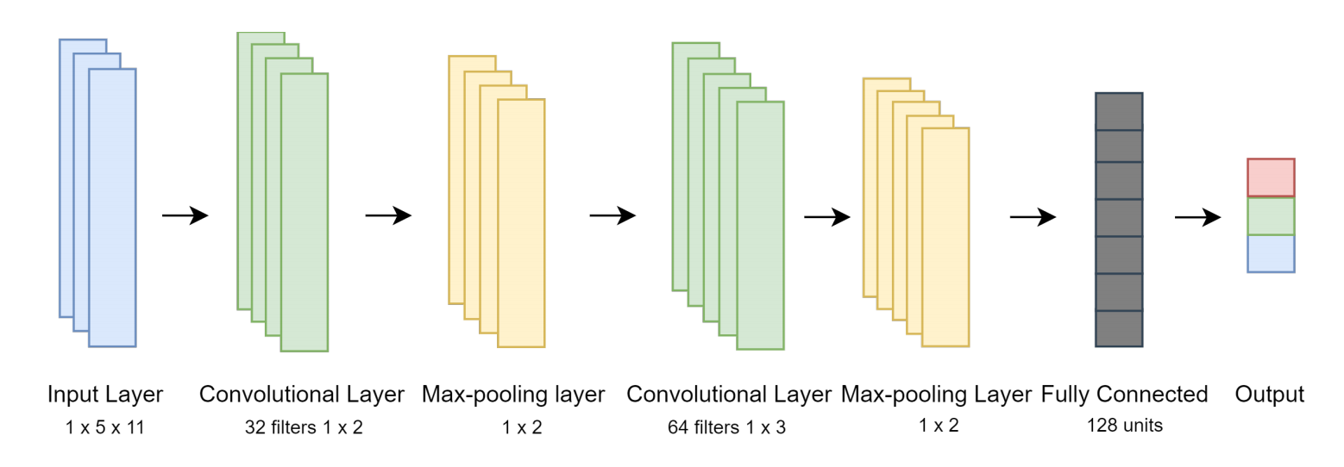
Convolutional Neural Network
Related Work
Traditional CNN architectures in computer vision always have multiple 2D convolutional layers followed by multiple dense layers, e.g. LeNet, AlexNet.
To adapt such structure to stock price prediction problem:
IMAGE / GRAPHIC
Mehtab, S., & Sen, J proposed to use 1D convolutional layers.
Lu et al. and Nascimento et al. discussed the probability of folding 1D stock data into a 2D matrix as Input.
Wang et al. introduced a new architecture with significant difference from traditional ones. Our model is based on this structure.
IMAGE / GRAPHIC
STAT 430 Fundamentals of Deep Learning

Slide 9
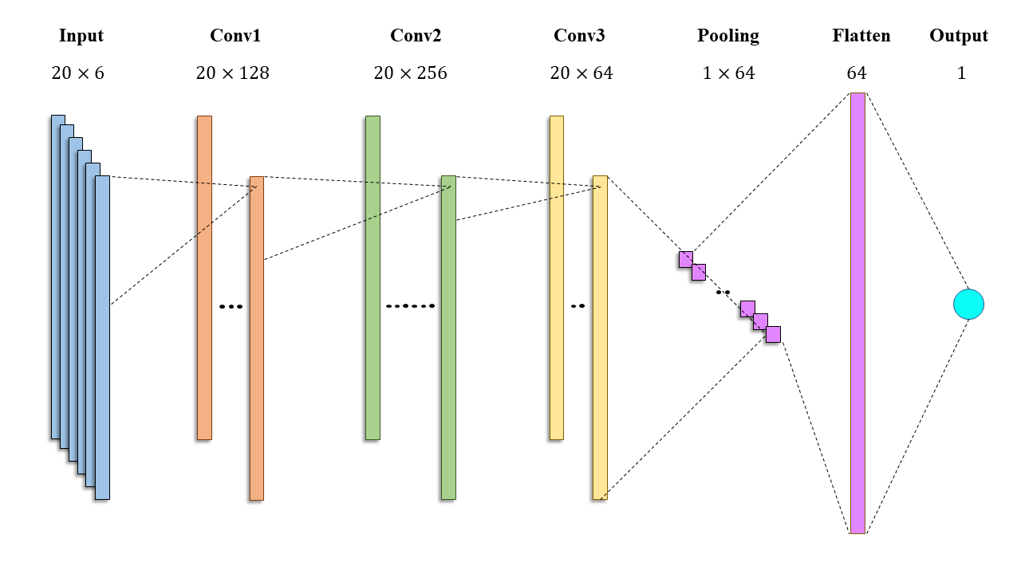
Convolutional Neural Network
Model Architecture
STAT 430 Fundamentals of Deep Learning

Slide 10
Convolutional Neural Network
Noteworthy characteristics
Global Average Pooling
Instead of max-pooling with a small kernel, an average-pooling layer with kernel size equal to input size is applied. Known as Global Average Pooling layer, it reduces each channel of input tensor down to 1 element, which is the average value.
Absence of fully connected layers
CNNs usually employ at least one fully connected layers after flatten to enlarge model capacity. However, in our architecture, fully connected layers are completely given up. We choose to output immediately after flattening. Such simplification endows our model with great generalization ability.
IMAGE / GRAPHIC
STAT 430 Fundamentals of Deep Learning

Slide 11
Results
STAT 430 Fundamentals of Deep Learning

Slide 12
Results
Model Evaluation
We use Root Mean Squared Error (RMSE) to evaluate our model.
On average ARIMA reaches the lowest RMSE.
LSTM outperforms ARIMA and CNN when predicting Procter & Gamble stock price.
 | LSTM | CNN | ARIMA
Amazon | 0.0223 | 0.0300 | 0.0222
Fachebook | 0.0319 | 0.0366 | 0.0317
Procter & Gamble | 0.0161 | 0.0194 | 0.0162
Microsoft | 0.0175 | 0.0194 | 0.0162
The RMSE table of three models for four stocks
STAT 430 Fundamentals of Deep Learning

Slide 13
Conclusion
STAT 430 Fundamentals of Deep Learning

Slide 14
Conclusion
Impact
The accuracy of the stock prices prediction can determine the profit investors can make and can also have a positive influence on the economy.
This project also compares the performance of stock market’s price prediction using the traditional linear model (ARIMA) with the non-linear models (LSTM, CNN)
Limitations & Improvements
Larger dataset can be used to train the model
Bi-directional LSTM, Gated Recurrent Unit (GRU) can be applied to achieve better performance
Combing CNN with LSTM or other network architectures to create better models.
STAT 430 Fundamentals of Deep Learning

Slide 15
Thank You
STAT 430 Fundamentals of Deep Learning

